Slide 1
Multiple Regression Part 2
STAT 441/541 Statistical Methods II

Slide 2
Objectives of Part 2
Assess the goodness of fit of the regression model
Check for multicollinearity among the independent variables
Predict new y values using the estimated multiple regression model
Check assumptions for regression analysis
Check for potential outliers by identifying observations with high leverage or influence

Slide 3
Sections Covered for Part 2
Chapter 12
12.6 Forecasting Using Multiple Regression
Chapter 13
13.4 Checking Model Assumptions

Slide 4
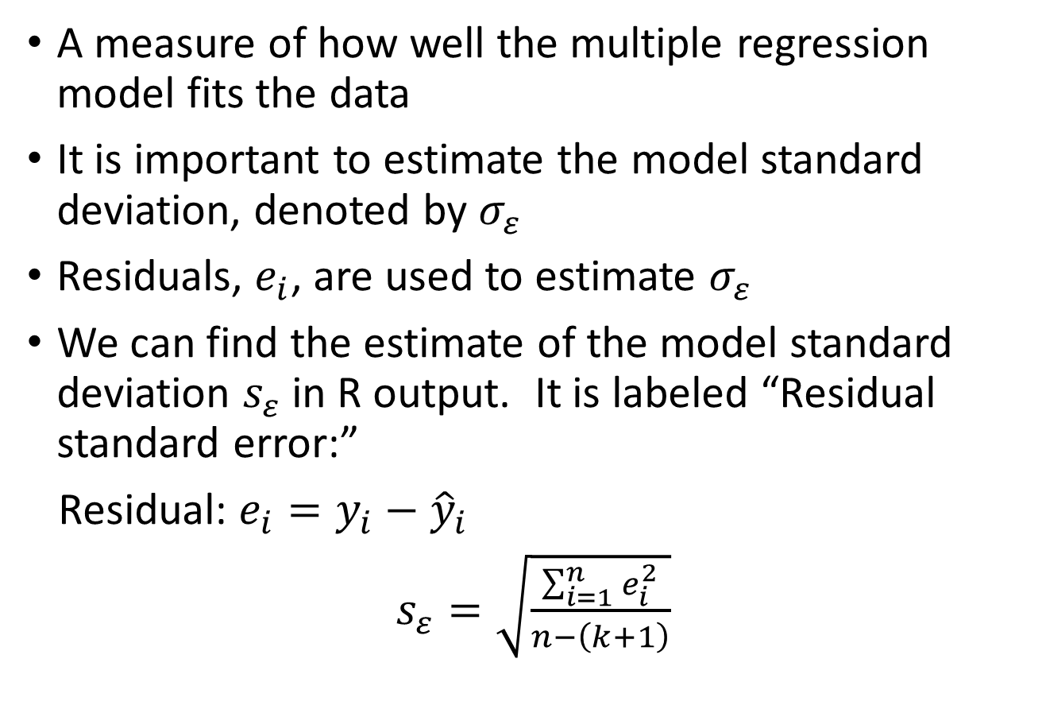
Model Standard Deviation
A measure of how well the multiple regression model fits the data
It is important to estimate the model standard deviation, denoted by $σ_{ε}$
Residuals, $e_{i}$, are used to estimate $σ_{ε}$
We can find the estimate of the model standard deviation $s_{ε}$ in R output. It is labeled “Residual standard error:”
Residual: $e_{i}=y_{i}−{\hat{y}}_{i}$
$s_{ε}=\sqrt{\frac{\sum_{i=1}^{n}{e_{i}^{2}}}{n−\left(k+1\right)}}$

Slide 5
Adjusted R-Squared
The Adjusted R-Squared value is also a measure of how well the multiple regression model fits the data
It is labeled as “Adjusted R-squared” in R output
Values of Adjusted R-squared are between 0 and 1
We can interpret Adjusted R-squared as the proportion of total variation in the response variable that is explained by the model
Values are often reported as a percentage
For example, “Adjusted R-squared: 0.7275” indicates that the multiple regression model explains over 70% of the total variation in the response variable

Slide 6
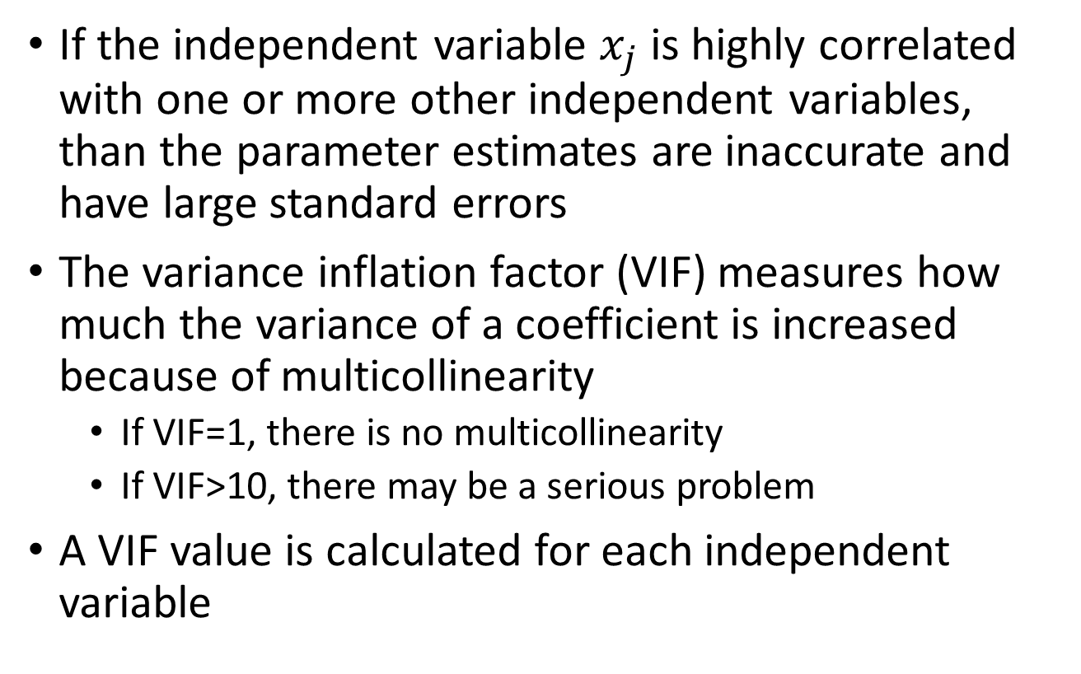
Effect of Multicollinearity
If the independent variable $x_{j}$ is highly correlated with one or more other independent variables, than the parameter estimates are inaccurate and have large standard errors
The variance inflation factor (VIF) measures how much the variance of a coefficient is increased because of multicollinearity
If VIF=1, there is no multicollinearity
If VIF>10, there may be a serious problem
A VIF value is calculated for each independent variable

Slide 7
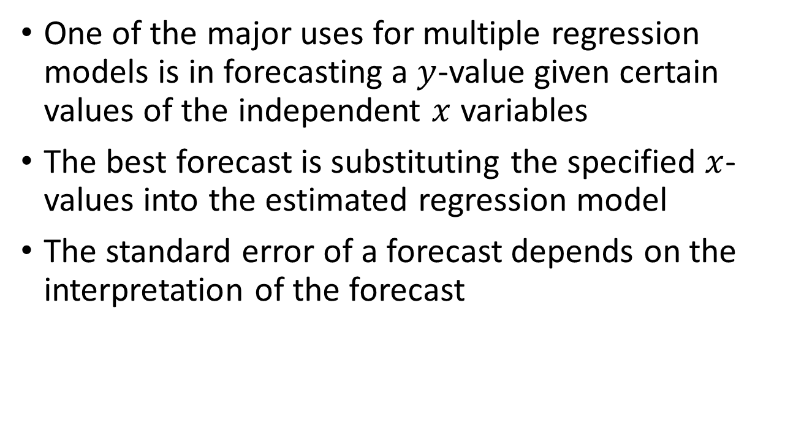
Section 12.6 Forecasting using Multiple Regression
One of the major uses for multiple regression models is in forecasting a $y$-value given certain values of the independent $x$ variables
The best forecast is substituting the specified $x$-values into the estimated regression model
The standard error of a forecast depends on the interpretation of the forecast

Slide 8
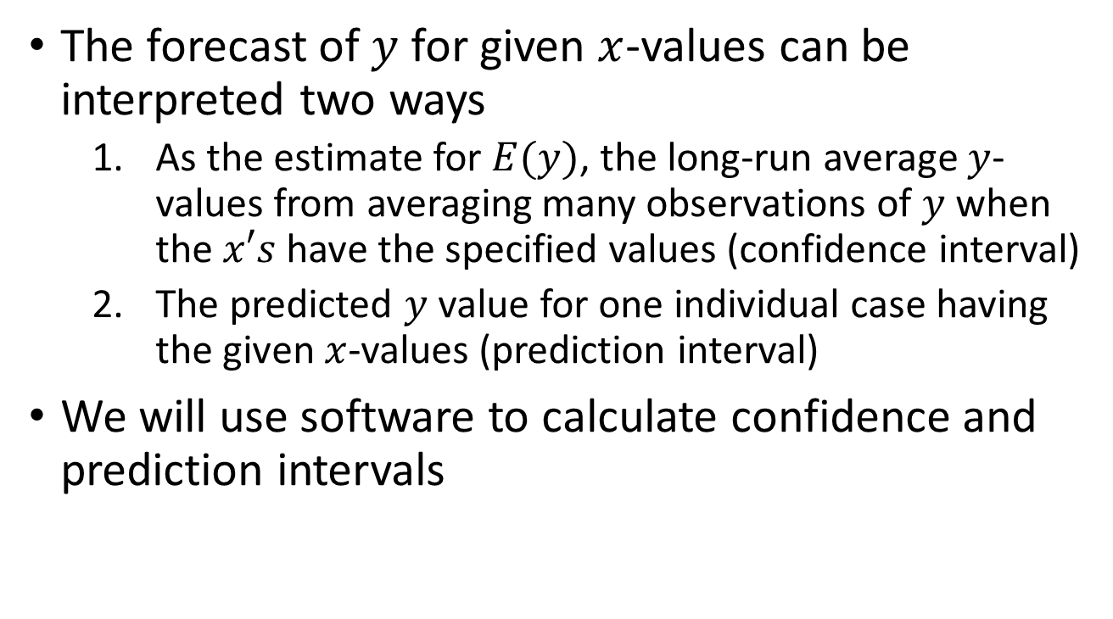
Two Interpretations for Forecasts
The forecast of $y$ for given $x$-values can be interpreted two ways
As the estimate for $E(y)$, the long-run average $y$-values from averaging many observations of $y$ when the $x′s$ have the specified values (confidence interval)
The predicted $y$ value for one individual case having the given $x$-values (prediction interval)
We will use software to calculate confidence and prediction intervals

Slide 9
Section 13.4 Checking Model Assumptions
It is always important to check assumptions for any statistical method
For multiple regression, we will use graphical and numerical methods. These include:
Diagnostic plots
Shapiro-Wilk Normality Test
Breusch-Pagan test for a common variance

Slide 10
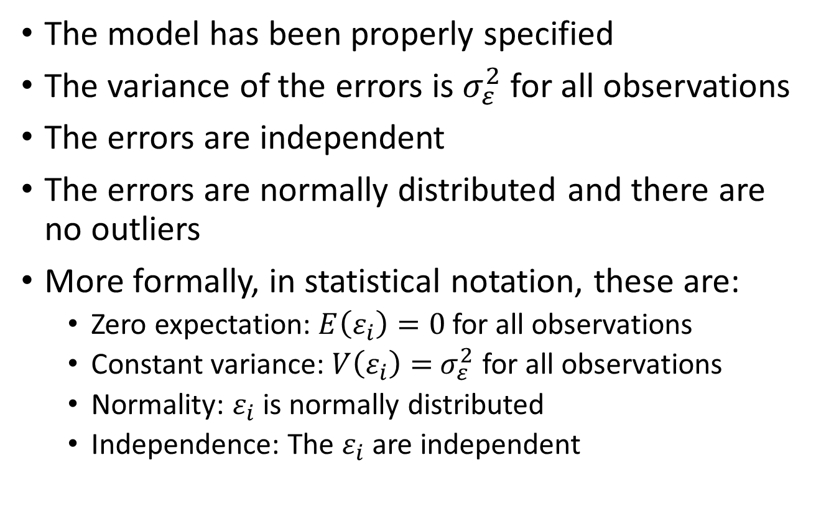
Assumptions for Multiple Regression
The model has been properly specified
The variance of the errors is${ σ}_{ε}^{2}$ for all observations
The errors are independent
The errors are normally distributed and there are no outliers
More formally, in statistical notation, these are:
Zero expectation: $E\left(ε_{i}\right)=0$ for all observations
Constant variance: $V\left(ε_{i}\right)={ σ}_{ε}^{2}$ for all observations
Normality: $ε_{i}$ is normally distributed
Independence: The $ε_{i}$ are independent

Slide 11
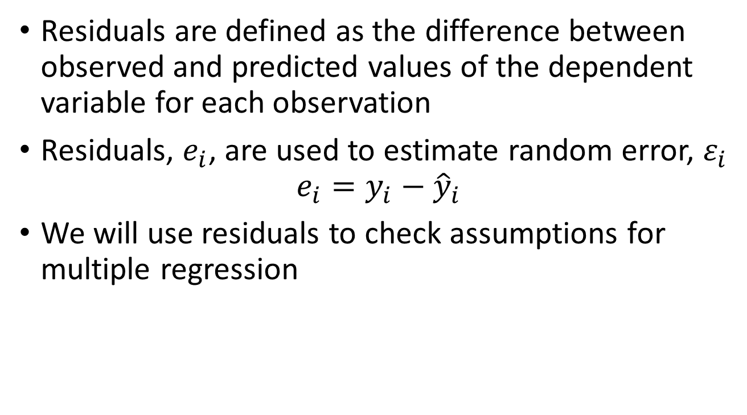
Checking Assumptions Using Residuals
Residuals are defined as the difference between observed and predicted values of the dependent variable for each observation
Residuals, $e_{i}$, are used to estimate random error, $ε_{i}$
$$e_{i}=y_{i}−{\hat{y}}_{i}$$
We will use residuals to check assumptions for multiple regression

Slide 12
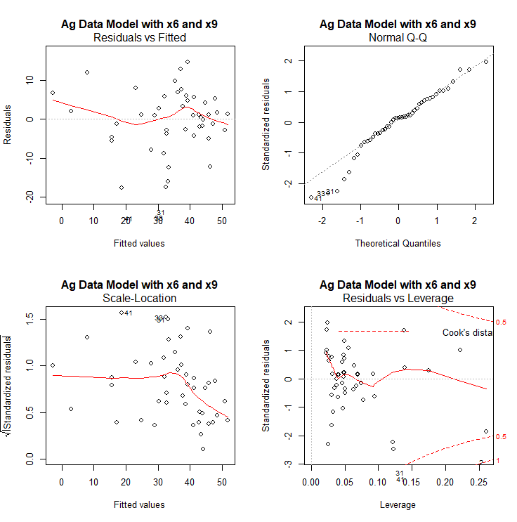
Diagnostic Plots
R provides four diagnostic plots based on residuals that help us visually check assumptions

Slide 13
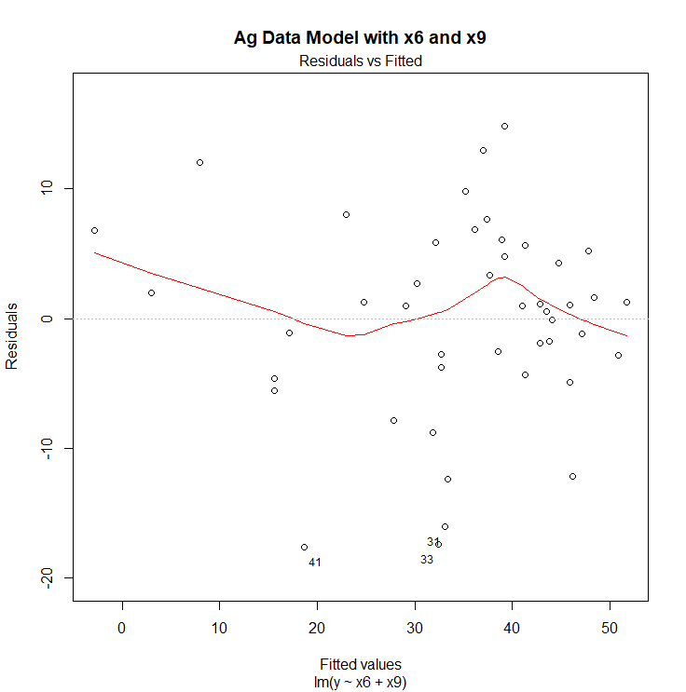
Residuals vs Fitted
Fitted, or predicted, values are on the horizontal axis and residuals are on the vertical axis
If the solid red line is horizontal or almost horizontal, then the model has been properly specified
Deviations from a horizontal line or nonrandom patterns of points may indicate the model needs to modified or the data transformed
Scan the plot from left to right to see if the residuals remain close to zero
Scan the plot from left to right to see if the spread of the residuals remain approximately constant
Check for points that are labeled and identify these as potential outliers

Slide 14
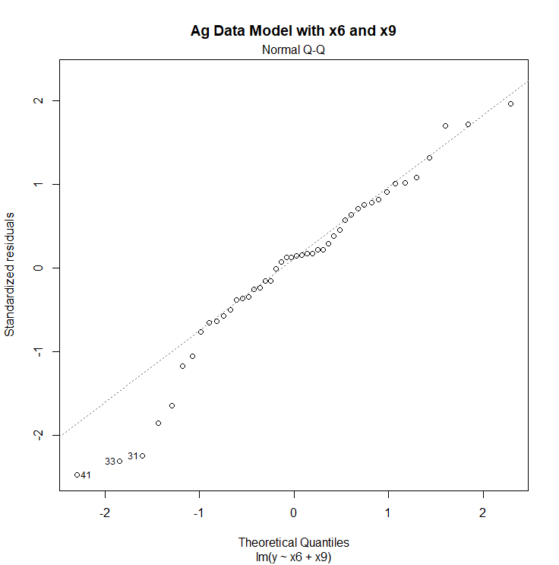
Normal Q-Q
Theoretical normal quantiles are on the horizontal axis and studentized residuals are on the vertical axis
If the points tend to follow the straight dashed line then the errors are normally distributed
Deviations from the straight dashed line or nonrandom patterns may indicate the model needs to modified or the data transformed
Check for points that are labeled and identify these as potential outliers

Slide 15
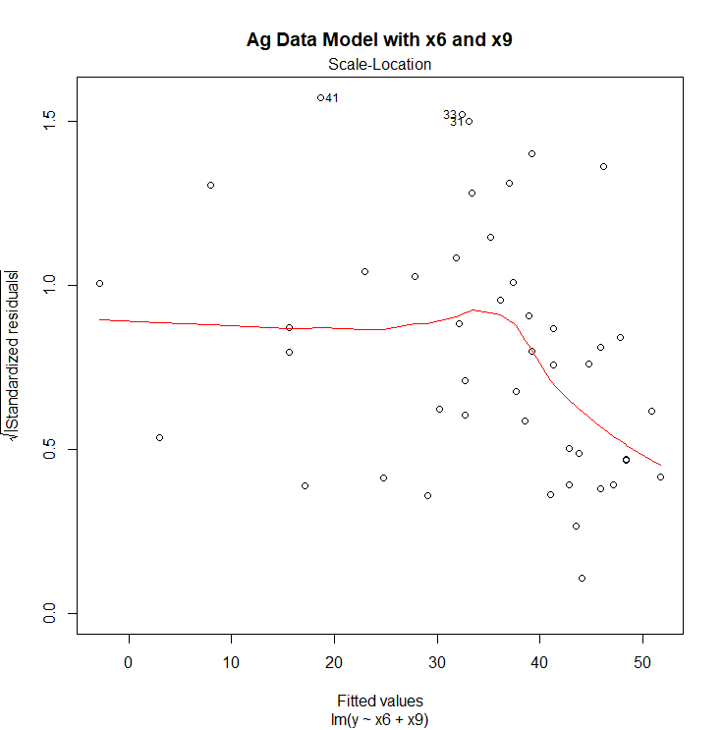
Scale-Location
Fitted, or predicted, values are on the horizontal axis and the square root of the absolute values of studentized residuals are on the vertical axis
If the solid red line is horizontal or almost horizontal, then there is a constant variance
If the solid red line is not horizontal or nonrandom patterns of points may indicate the model needs to modified or the data transformed
Check for points that are labeled and identify these as potential outliers

Slide 16
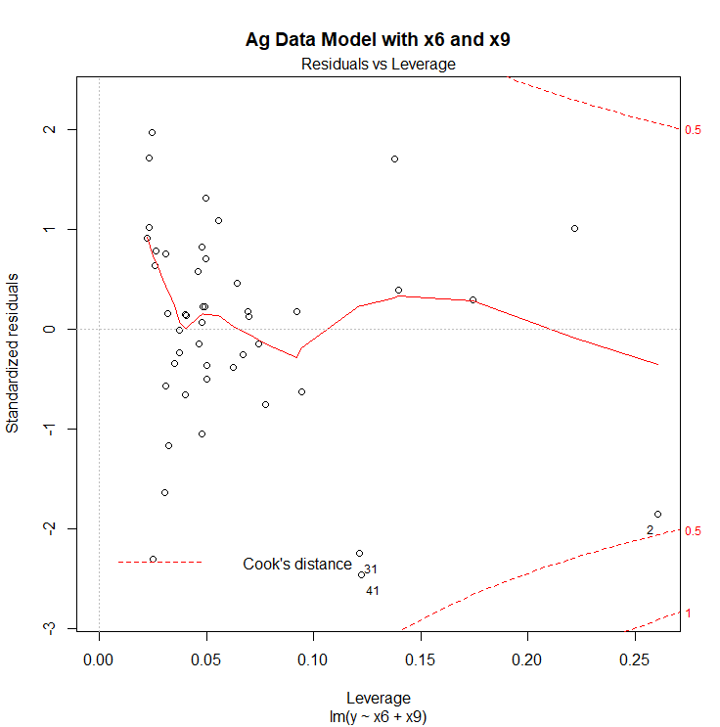
Residuals vs Leverage
Leverage values are on the horizontal axis and studentized residuals are on the vertical axis
Look for points that have Cook’s distance greater than one and are plotted beyond the red dashed line labeled “1”
Check for points that have Cook’s distance greater then one and labeled with observation number. These will be in the upper right corner and/or lower right corner of the plot. Identify these as potential outliers since they exhibit undue influence or leverage for estimating model parameters

Slide 17
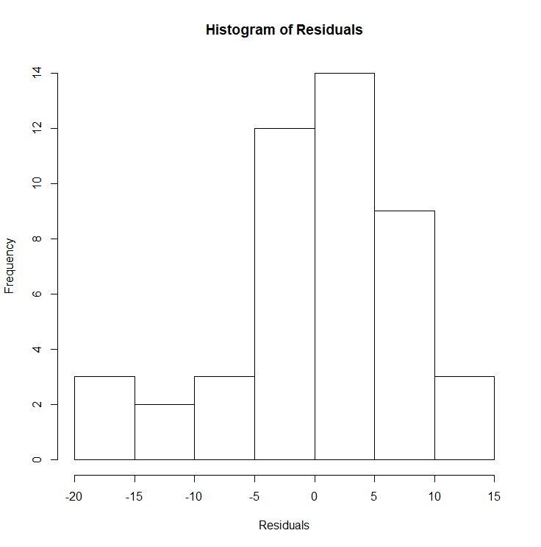
Histogram of Residuals
Look for a shape that is bell-shaped, symmetrical, no gaps, and no outliers
Should keep in mind that a histogram’s appearance is influenced by a small number of observations

Slide 18
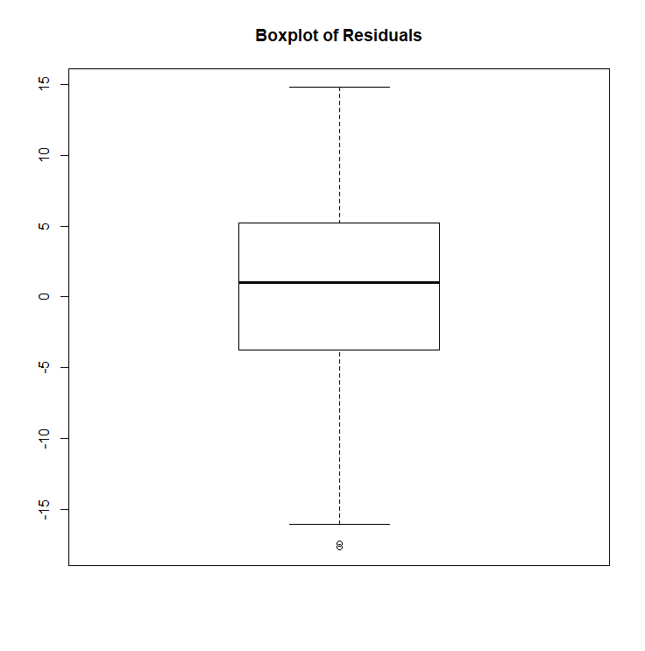
Boxplot of Residuals
Look for whiskers that are similar in length
Look for the solid line in the box (the median) to be near the center of the box
Look for points that are plotted with open circles, these are potential outliers

Slide 19
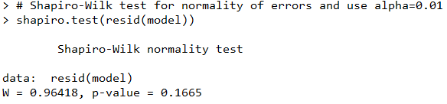
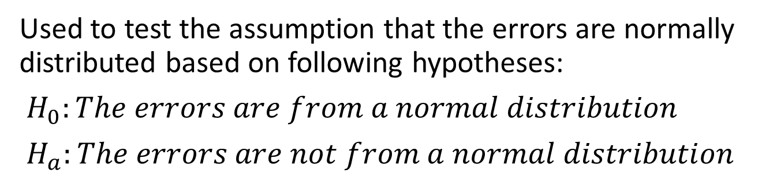
Shapiro-Wilk Test for Normality
Used to test the assumption that the errors are normally distributed based on following hypotheses:
$H_{0}:The errors are from a normal distribution$
$H_{a}:The errors are not from a normal distribution$

Slide 20
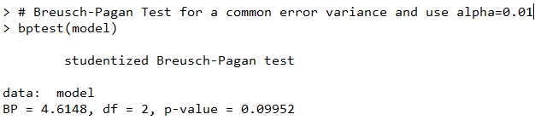
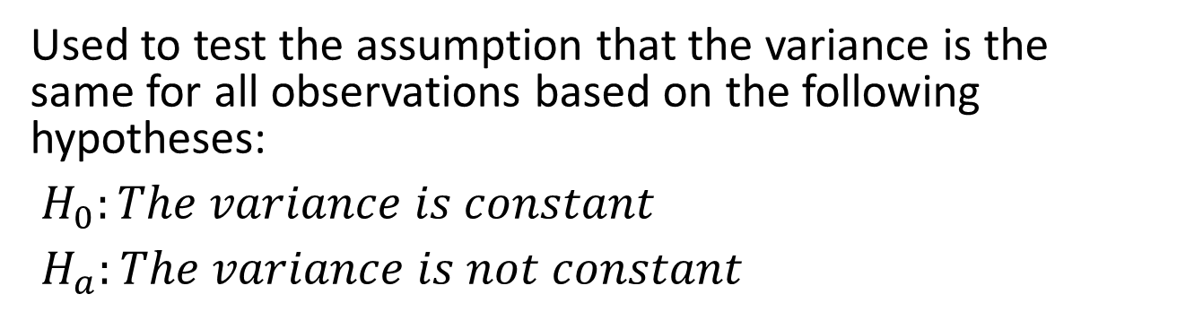
Breusch-Pagan Test for Constant Variance
Used to test the assumption that the variance is the same for all observations based on the following hypotheses:
$H_{0}:The variance is constant$
$H_{a}:The variance is not constant$

Slide 21
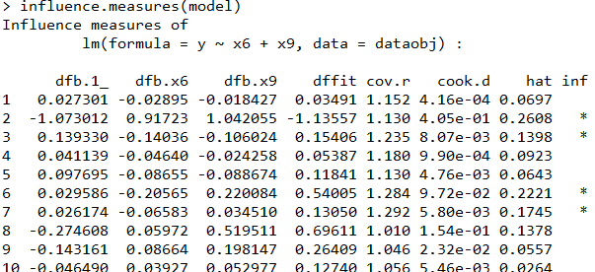
R Function influence.measures
This function uses several methods to identify observations that have high leverage or influence. An “*” marks those observations that have an impact on the multiple regression model
dfbetas
dffit
cov.r
cook.d
hat

